Slide 2
Working with Legacy Apps
Olabamiji Taiwo
Developer Academy
November, 2018

Slide 3
Content
Introduction
Reasons to change software
Legacy Code Change Algorithm
Identify the change points
Identify what to test
Solving the dependency problem (Internal & External)
Create a Safety Net
Make the changes and refactor
Hands-on

Slide 4
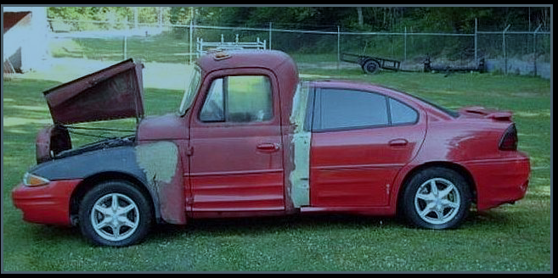
What’s a legacy code

Slide 5
What’s a legacy code
source code inherited from someone else and source
code inherited from an older version of the software”
(Wikipedia)
“code without tests”
(Michael Feathers)
Running in production
Functional
Delivering business value
Must keep working
Code maintenance is hard
Outdated
Expensive and difficult changes
No test

Slide 6
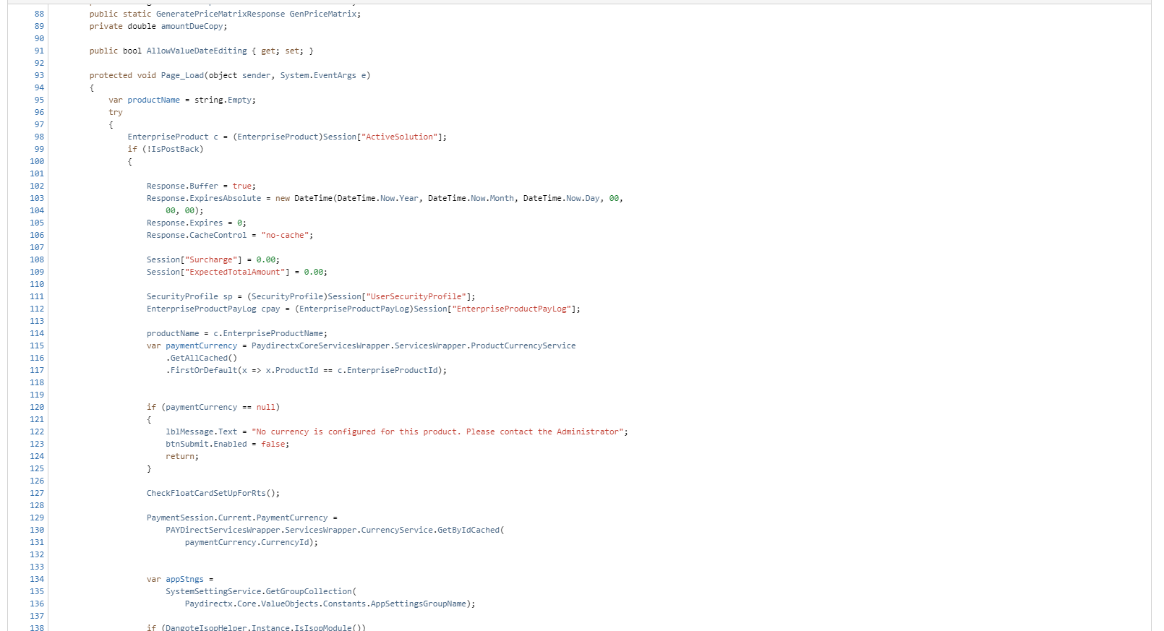
What’s a legacy code

Slide 7
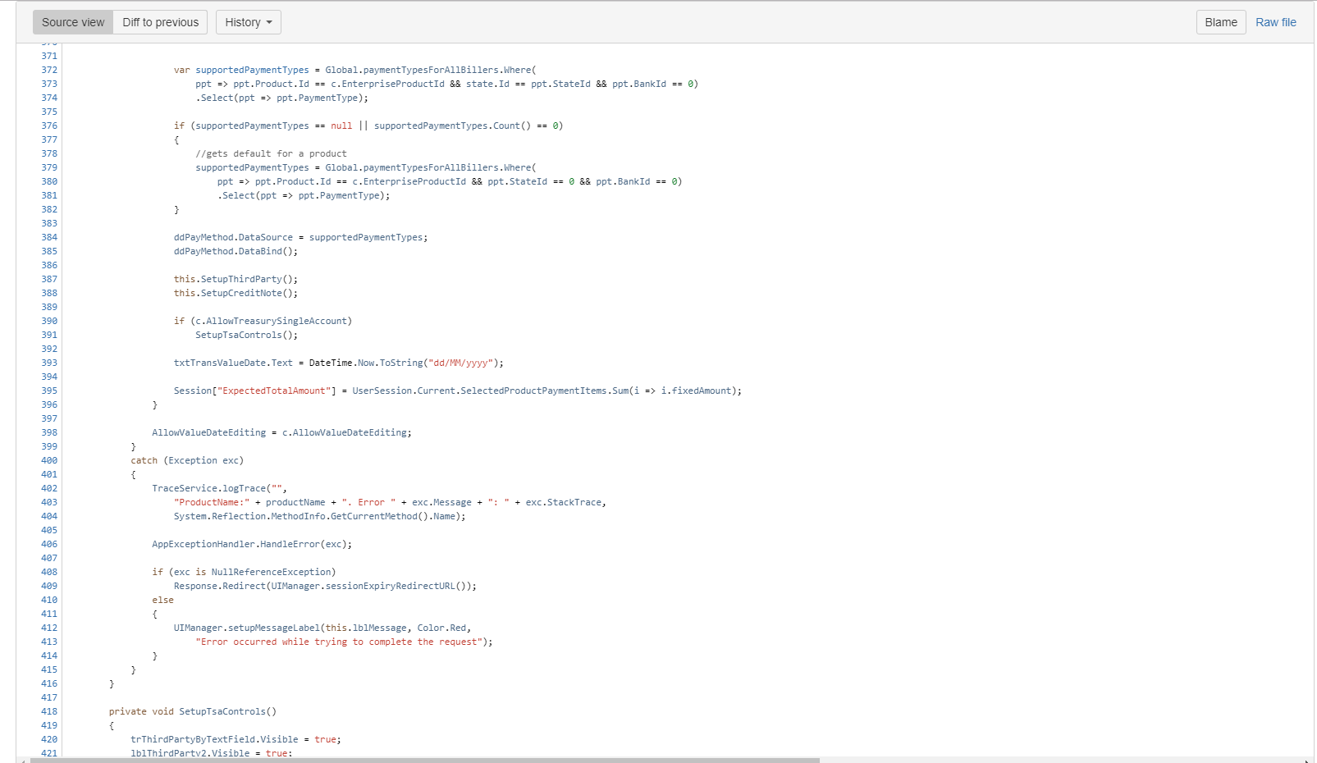
What’s a legacy code

Slide 8
Gall’s Law: states that all complex systems that work evolved from simpler systems that worked.

Slide 9
Reasons to change software
Fixing a bug
Adding a feature
Improving the design
Optimizing resource usage

Slide 10
Legacy Code Change Algorithm
Legacy Code Change Algorithm
Make the change
Create a safety net
Solve the dependency problem
Identity what to test
Identify the change points

Slide 11
Identify the change points
This is driven by Change Request (CR), JIRA Issue and Engineering Friday
Study the design and architecture doc on Confluence
Understanding the Source Code Structure. This is your Legacy Code Compass
Ask questions
Debugging - The Brute Force Way

Slide 12
Solve the dependency problem
Identify the Internal Code Dependency
Identify the External Code Dependency
The Art of Refactoring
The objective is to make code testable
Do not optimize while refactoring, separate step, refactoring is NOT optimizing
Refactoring because it’s not your way is a waste
Don’t touch components you are not going to change.
A refactoring improves the design without changing behaviour
Tests ensure that behaviour is not accidentally changed
Without tests, refactoring is scary and with no refactoring, the design decays over time

Slide 13
Create a Safety net
Write Unit Test for Change Point
Mock external dependencies

Slide 14
Make the change
Git Branch Strategy for Feature and Bug
Edit and Pray* (where exactly should I put this)
Write Clean Code
Running the Test
Running Regression Test

Slide 15
Skills for working with legacy apps
Debugging
Refactoring
Testing
Clean code

Slide 16
Hand On
Hands-on example 1: Adding a feature to AppX
Hands-on example 2: Fixing a bug on AppX

Slide 17
Thank you
Interswitch Limited

